Slide 1
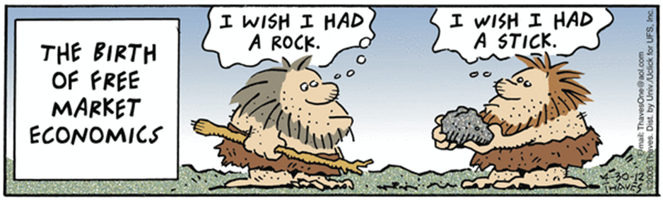
Producer Choice
How Firms Behave

Slide 2

What are Profits?

Slide 3
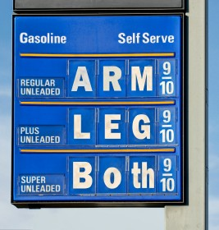
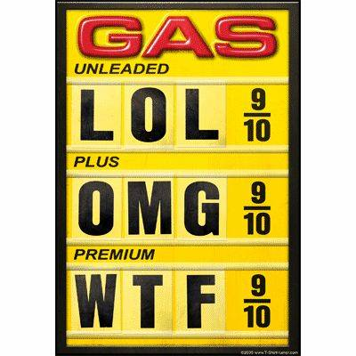

Slide 4

Profit$$

Slide 5
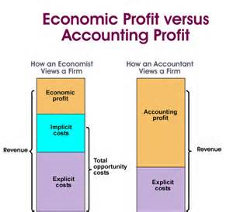
Types of Profit
Economic
Accounting
Includes opportunity Costs
$$$$ and cents

Slide 6
Types of Profit
Accounting
Economic
TR= P*Q
Accounting Profit: TR- TC
Explicit Costs Only!
Is it worth being an entrepreneur?
Opportunity Costs= Implicit Costs
Economic Profit= TR- TC (including Implicit Costs)
Normal Economic Profits= 0

Slide 7
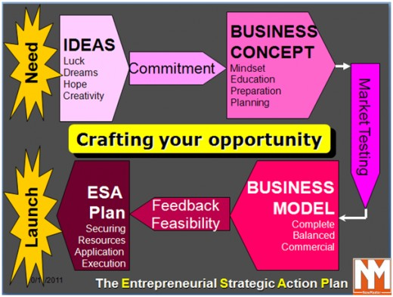
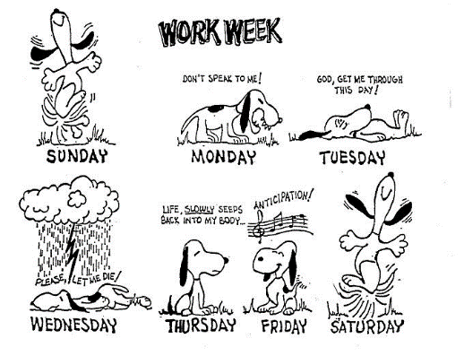
Implicit (opportunity) Costs
Does not require an outlay of money. Its worth is based on value

Slide 8
Types of Profit
Accounting
Economic
TR- Explicit Costs
TR- Opportunity Costs
OC= IC + EC
Opportunity (economic)
Cost

Slide 9

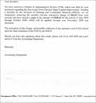
Explicit Costs
Costs that business managers pay out of pocket because they must be paid.
Some Explicit Costs Include:
1.wages
2.taxes
3.rent
4. machinery

Slide 10
What is Normal Profit?
When Economic Profit =

Slide 11
0

Slide 12
Profit Maximization
TR= P * Q
Profit= TR- TC
MR= Change in TR/ Change in Q
MR= MC that’s were you want to be!

Slide 13
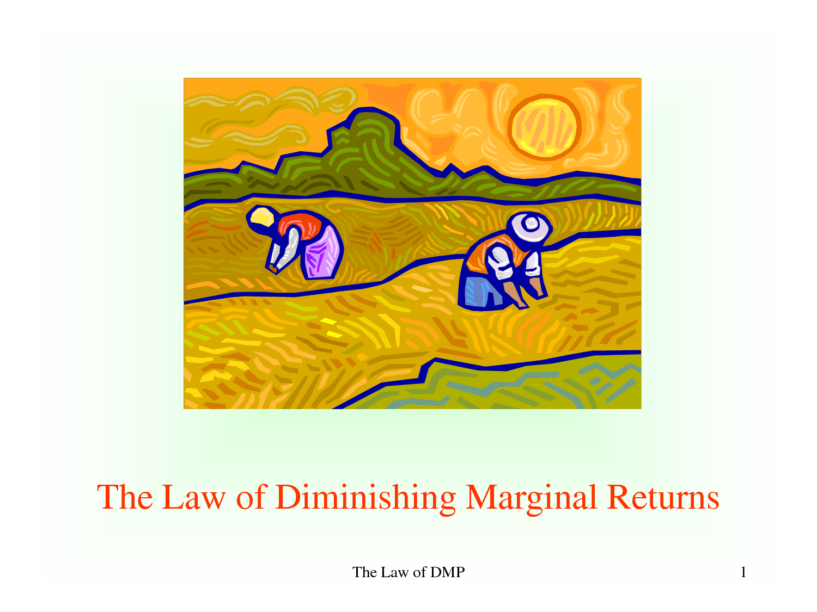

Slide 14
How many people should a firm hire?
Total Physical Product (TPP)
Average Physical Product (APP)
total product/ units of labor
Marginal Physical Product (MPP)
change in total product/ change in labor input

Slide 15

Diminishing Returns

Slide 16
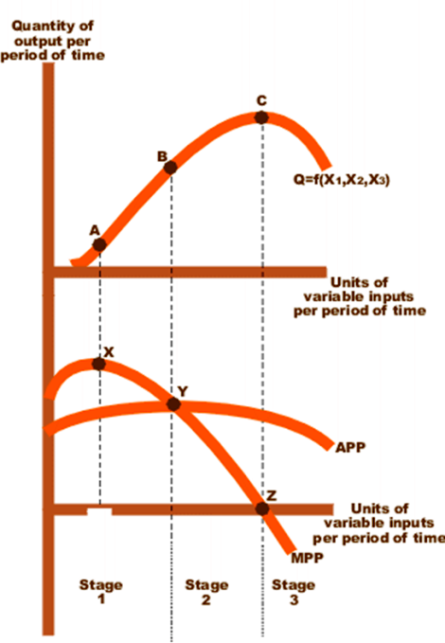
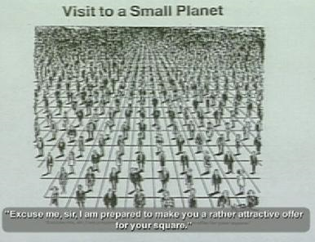
Production Graphs
Law of Diminishing Returns

Slide 17
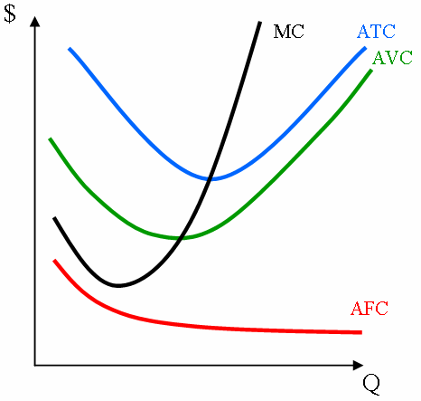
Eventually- By the End of the Block

Slide 18
TC= FC +VC
Total Costs
Fixed Costs: those that do not vary with change in output (independent)
Variable Costs: those that change with the level of output (dependent)

Slide 19


Sunk Costs
Can’t do anything about it
“What’s done is done”
“Give me your wand”

Slide 20

Average Costs
AFC= TFC/Q
AVC= TVC/Q
ATC= AFC + AVC

Slide 21
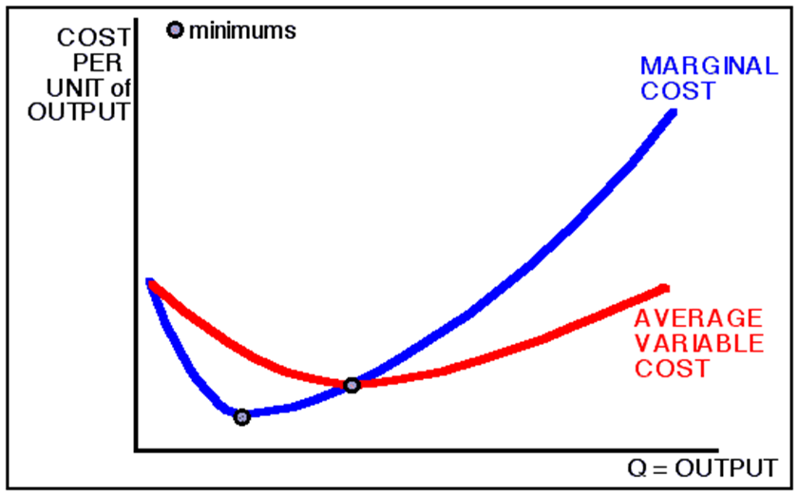
Marginal Costs
MC= additional (extra) costs of production, (1 more unit of output)
MC= change in TC/ change in Q

Slide 22
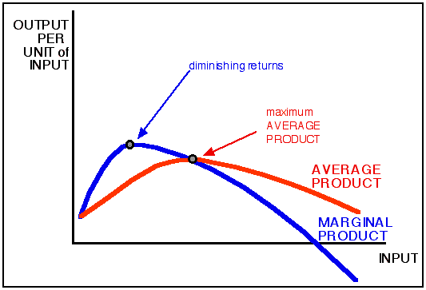
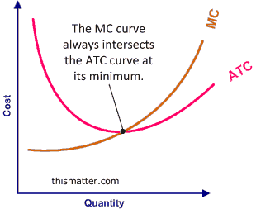
Relationship Between Production Curves and Cost Curves
Product Costs

Slide 23
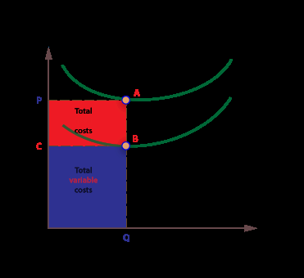
Total Cost Graphs

Slide 24
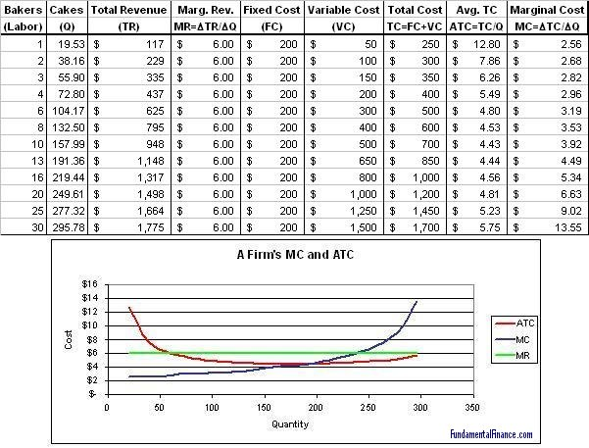
Table Talk

Slide 25
Long Run and Short Run
Short Run has some fixed costs
Is it time to cut costs or build a new plant?
Returns to Scale
All costs are variable
Economies of Scale
Diseconomies of Scale

Slide 26
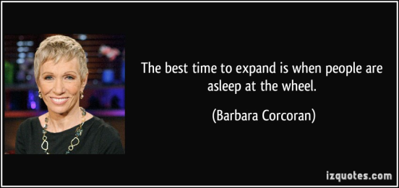
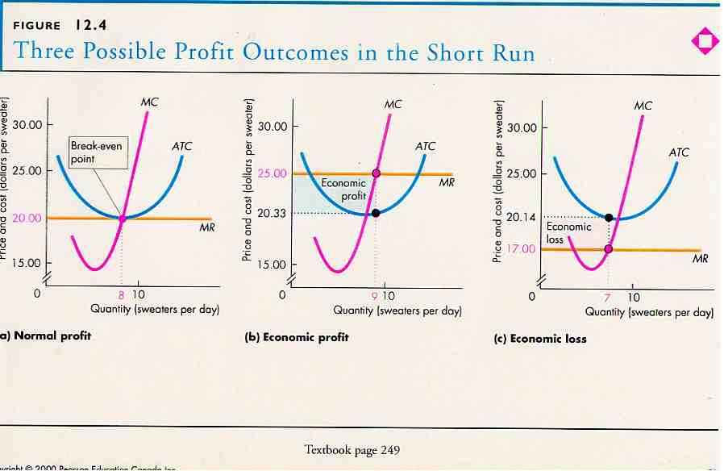
Is it time to expand or cut back?
Short Run
Long Run
At least one fixed cost
Usually land or capital
All costs are variable
No exact time frame

Slide 27
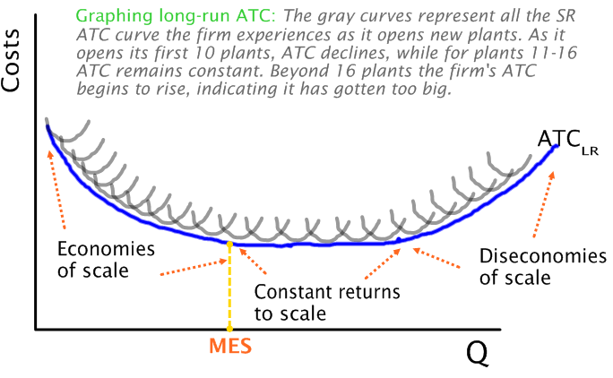
Long- Run Graphs
All costs are variable
When is it time to expand your firm?

Slide 28
Long Run Decisions
Economies of Scale: long-run ATC is downward sloping
Constant Returns to Scale: long- run ATC is horizontal
Diseconomies of Scale: long run ATC is upward sloping

Slide 29
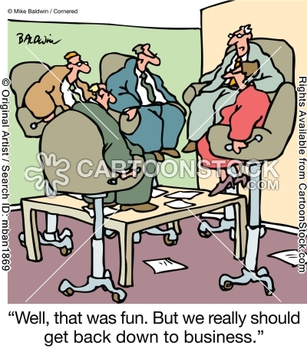
Why do business people study these graphs?

Slide 30
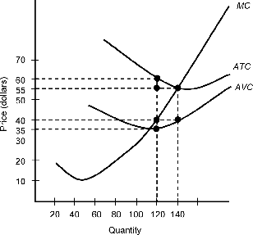
You got this!

